Slide 1

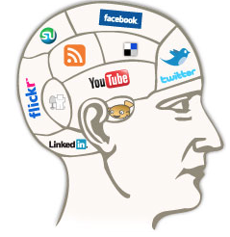

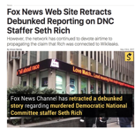
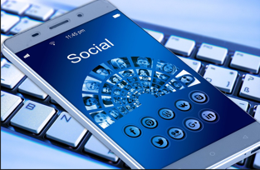
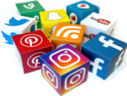

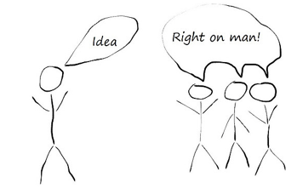




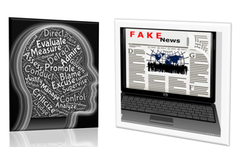

Information Professionals’ Roles in a Post-Truth Era
Introduction
This study seeks to create context for library services in a “post-truth” reality, and also to assist librarians exploring their roles in terms of critical librarianship. The Oxford English Dictionary named “post-truth” the word of the year for 2016. The ALA affirms accurate information is a core librarianship value. Facts in public discourse are personalized, relative, and “alternative” rather than objective. Often information is weaponized. Given recent current events in which public trust in the media is now being overtly undermined by elements in the government, as well as other social and political forces, information literacy is crucial in order for an informed citizenry to participate fully in a democracy.
Definitions
“Critical librarianship takes the position that, “neutrality is not only unachievable, it is harmful to oppressed groups in our society” (Farkas, 2017).
Misinformation: Information that has been shown to be inaccurate, can include concealment, ambivalence, distortion, and falsification.
Disinformation: False information which is intended to mislead, especially propaganda issued by a government organization to a rival power or the media. Can include advertising, business and political info, doctored photos, forged documents and fake maps (OED, Fallis, 2015).
Post-Truth: Relating to or denoting circumstances in which objective facts are less influential in shaping public opinion than appeals to emotion and personal belief (OED).
Truthiness: The quality of seeming or being felt to be true, even if not necessarily true.
Also, The quality of seeming to be true according to one's intuition,
opinion, or perception without regard to logic, factual evidence, or the like;
the growing trend of truthiness as opposed to truth. (Dictionary.com)
Information warfare: “A state-conducted, strategic series of information and psychological operations that influences the target’s opinions, attitudes and actions in order to support the political goals of the state’s leaders” (Aro, 2016).
Filter Bubble: The restriction of a user's perspective that can be created by personalized search technologies.(whatis.techtarget.com)
Information Literacy: “Information literacy is a set of abilities requiring individuals to recognize when information is needed and have the ability to locate, evaluate, and use effectively the needed information…also is increasingly important in the contemporary environment of rapid technological change and proliferating information resources”(ALA.org).
Digital Literacy: Digital behaviors, practices and identities’ involving critical thinking, reflection, and life-long learning, communication, collaboration, and social engagement. -ALA
Confirmation Bias:
The tendency to interpret new evidence as confirmation of one's existing beliefs or theories. (Encyclopedia Britannica)
Methods
A qualitative exploratory and descriptive multiple case study with a sample of small, mid-sized and large public libraries will survey librarians’ perceptions of their roles and problems associated with “post-truth” society.
Information literacy programming will be analyzed by examining websites and policy documents describing the planning and implementation process of education efforts.
The selection criteria will attempt to reflect a wide range of settings with racially, ethnically, economically and geographically diverse populations.
Semi-structured interviews will be conducted with librarians.
Research Questions
What do librarians actually perceive their roles to be in this information environment and political moment?
Do they embrace critical librarianship and perceive libraries as the solution to the stated problem?
What are public libraries doing in terms of programming and information literacy?
Expected Contribution to Field
Study results will inform practice grounded in librarianship’s long tradition of social justice. Surveying programming trends and perceptions of roles will orient others seeking to develop information literacy programming and services.
Notes:
References: Aro, J. (2016). “The cyberspace war: propaganda and trolling as warfare tools. “European
View, 15(1), 121-132.; Fallis, D. (2015). “On verifying the accuracy of information: philosophical perspectives”.
Library Trends. 63 (3) p. 401-426.; Farkas, M.(2017) “Never neutral: Critical librarianship and technology”. American Libraries;
Magazine. https://americanlibrariesmagazine.org/2017/01/03/never-neutral-critlibtechnology/;
Garcia, A. (2017). “Fox news web site retracts debunked reporting on DNC staffer Seth Rich.” Snopes. http://www.snopes.com/2017/05/23/fox-story-seth-rich-retraction/;
Martzoukou, K., & Elliott, J. (2016). “The development of digital literacy and inclusion skills of
public librarians.” Communications in Information Liiteracy, 10(1), 99.; Walsh, J. (2010). “Librarians and controlling disinformation: Is multi-literacy instruction the
answer?” Library Review, 59(7), 498-511.
doi:http://dx.doi.org.proxy.ulib.uits.iu.edu/10.1108/00242531011065091.

Slide 2

Information Professionals’ Roles in a Post-Truth Era
Introduction
This study seeks to create context for library services in a “post-truth” reality, and also to assist librarians exploring their roles in terms of critical librarianship. The Oxford English Dictionary named “post-truth” the word of the year for 2016. The ALA affirms accurate information is a core librarianship value. Facts in public discourse are personalized, relative, and “alternative” rather than objective. Often information is weaponized. Given recent current events in which public trust in the media is now being overtly undermined by elements in the government, as well as other social and political forces, information literacy is crucial in order for an informed citizenry to participate fully in a democracy.

Slide 3
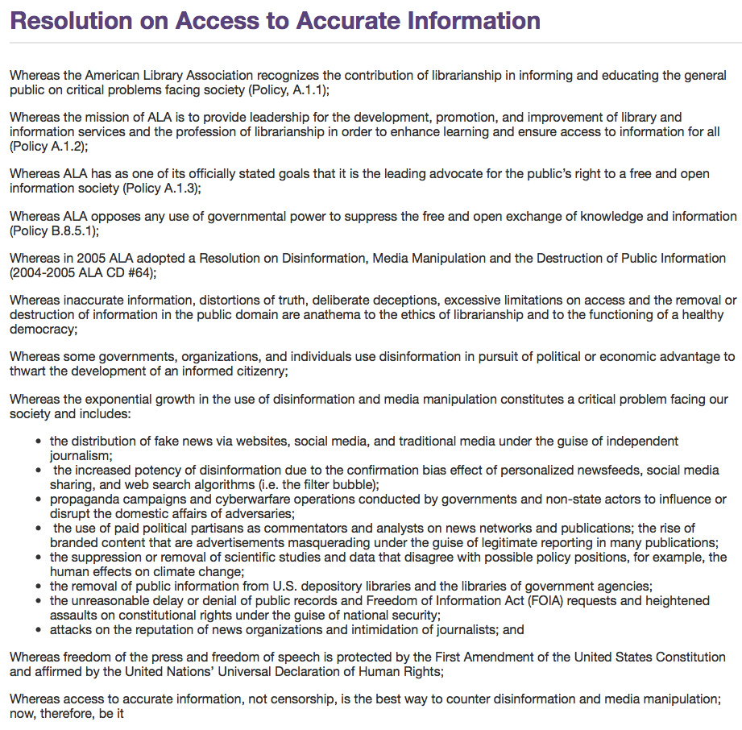

Slide 4
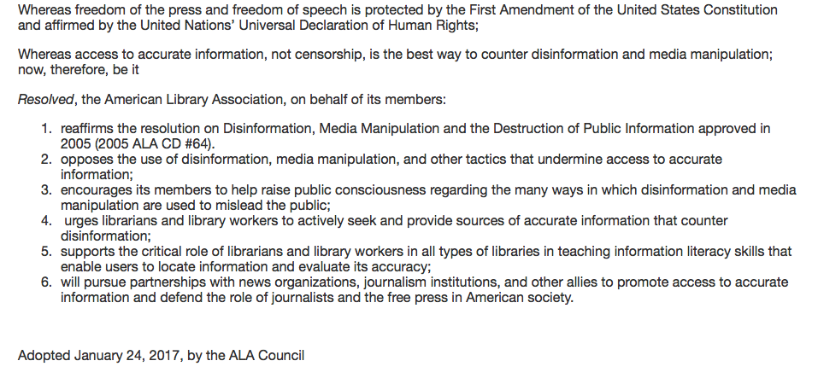
Resolution on Access to Accurate Information

Slide 5
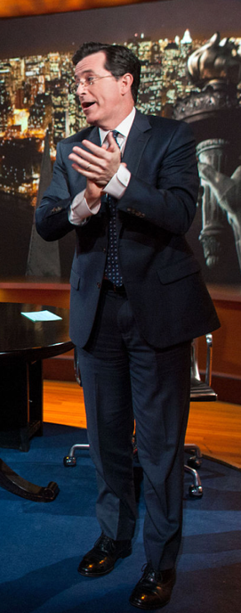
Definitions
Truthiness:
The quality of seeming or being felt to be true, even if not necessarily true.
Also,
The quality of seeming to be true according to one's intuition, opinion, or perception without regard to logic, factual evidence, or the like:
the growing trend of truthiness as opposed to truth.
Post-Truth:
Relating to or denoting circumstances in which objective facts are less influential in shaping public opinion than appeals to emotion and personal belief.

Slide 6
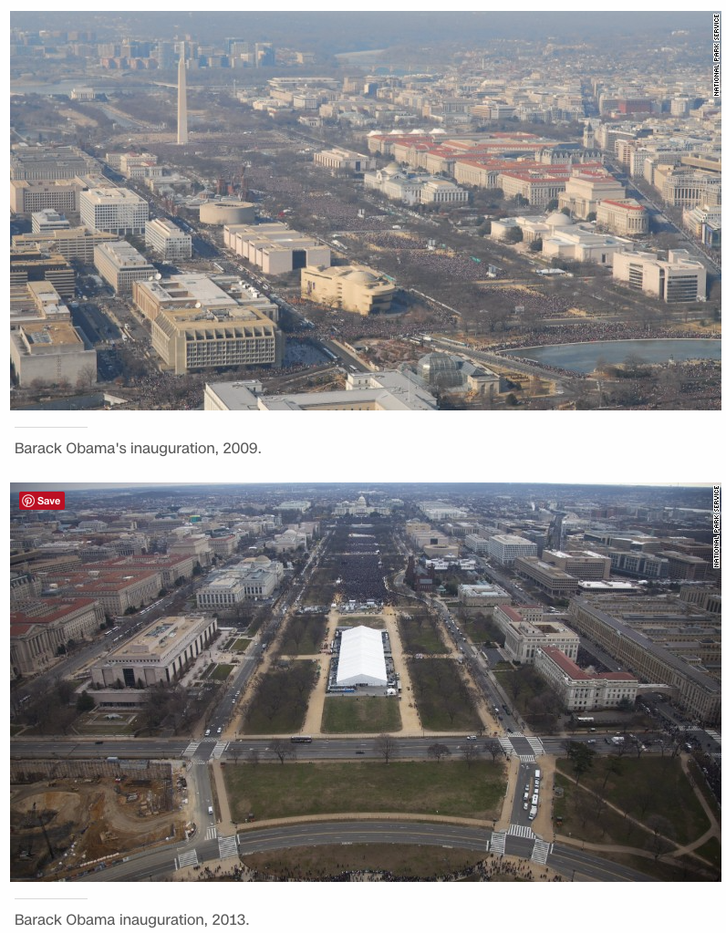
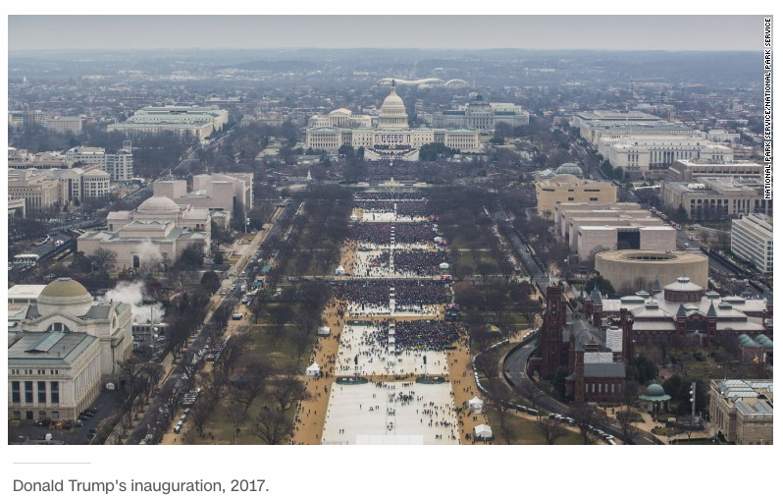
Post-Truth Era: Example
Despite factual evidence to the contrary, White House Press Secretary Sean Spicer claimed Donald Trump’s inauguration had the largest attendance in history.
Notes:
http://www.cnn.com/2017/03/07/politics/national-park-service-inauguration-crowd-size-photos/

Slide 7
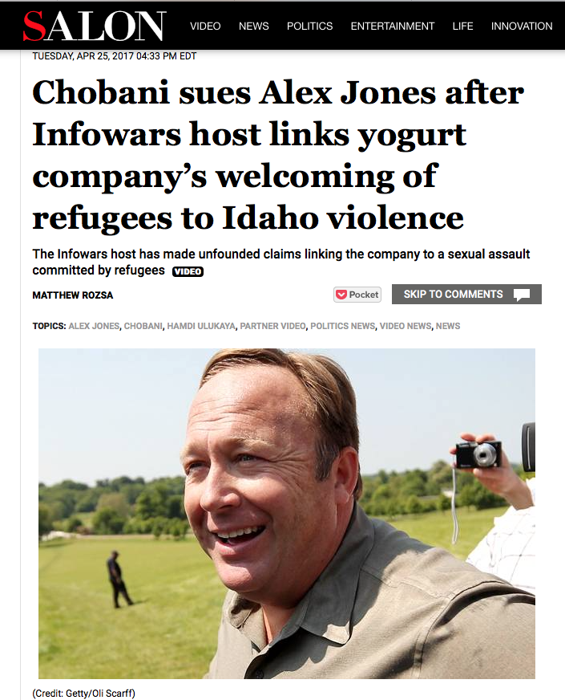
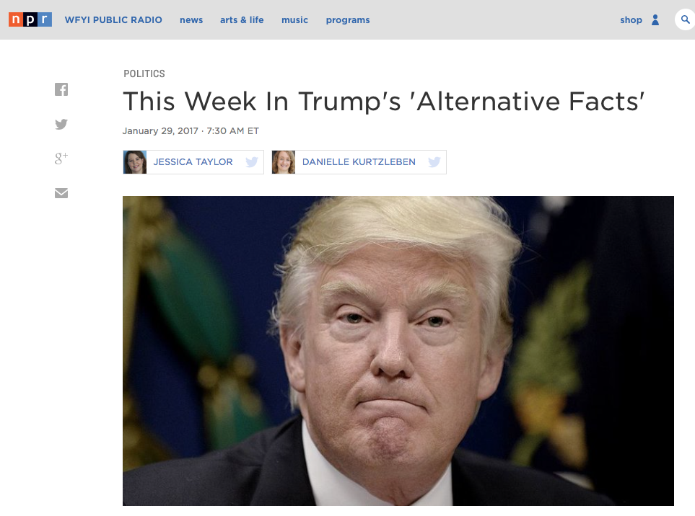
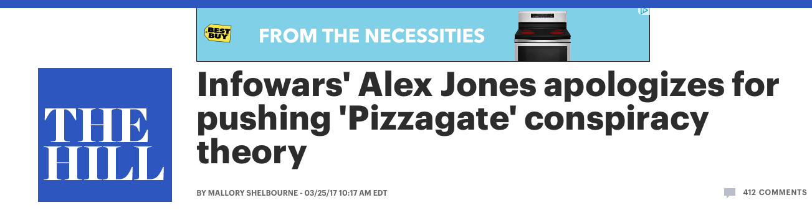
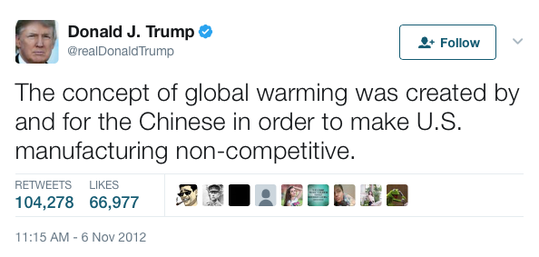
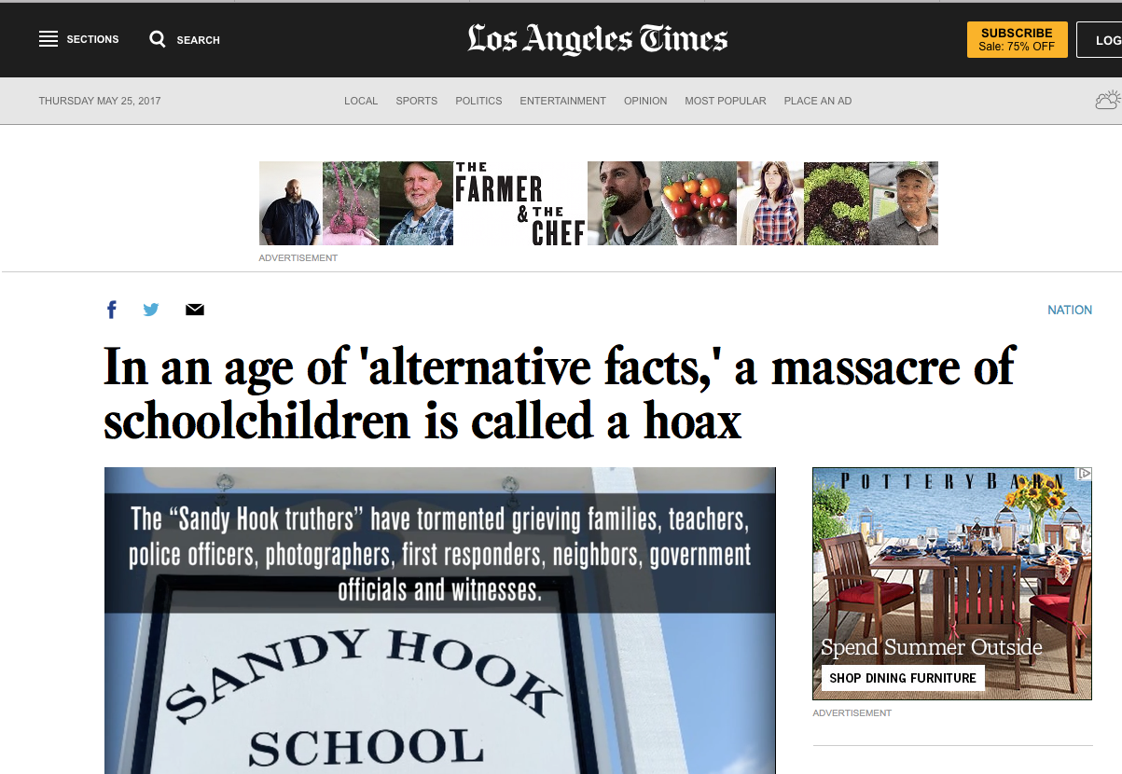
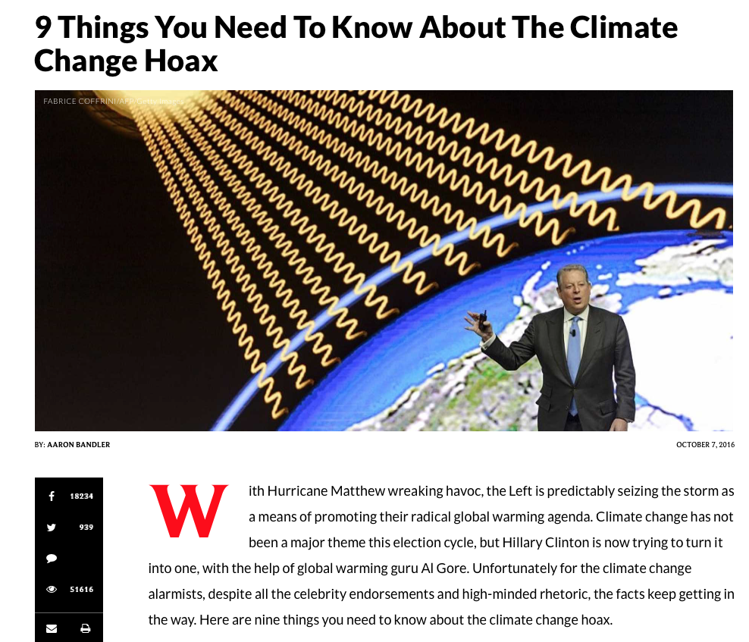
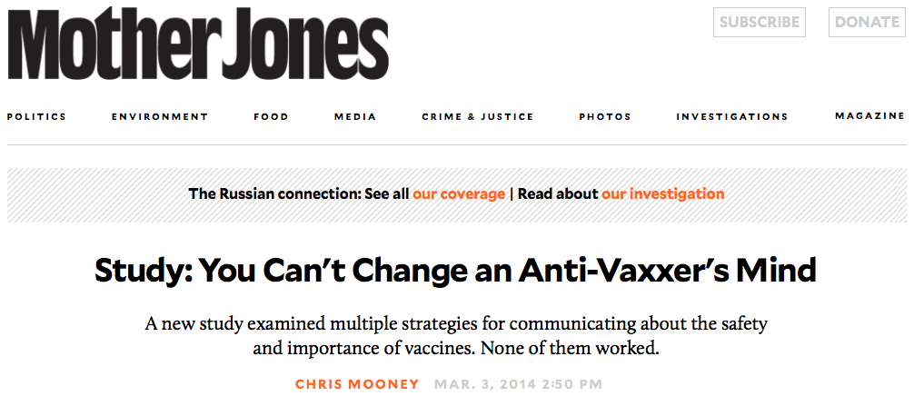
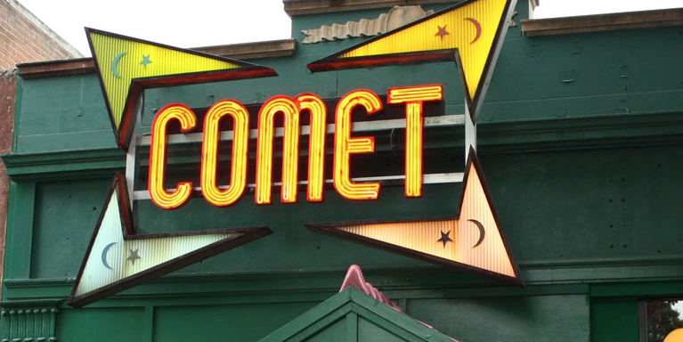
Alternative Facts
Notes:
http://www.latimes.com/nation/la-na-sandy-hook-conspiracy-20170203-story.html
http://thehill.com/homenews/325761-infowars-alex-jones-apologizes-for-pushing-pizzagate-conspiracy-theory
http://www.salon.com/2017/04/25/chobani-sues-alex-jones-after-infowars-host-says-yogurt-companys-workers/
http://www.npr.org/2017/01/29/512068148/this-week-in-trumps-alternative-facts
http://www.motherjones.com/environment/2014/02/vaccine-denial-psychology-backfire-effect
https://twitter.com/realdonaldtrump/status/265895292191248385?lang=en
http://www.dailywire.com/news/9767/9-things-you-need-know-about-climate-change-hoax-aaron-bandler

Slide 8
Definitions
Critical librarianship takes the position that, “neutrality is not only unachievable, it is harmful to oppressed groups in our society” (Farkas, 2017).
Misinformation: Information that has been shown to be inaccurate, can include concealment, ambivalence, distortion, and falsification.
Disinformation: False information which is intended to mislead, especially propaganda issued by a government organization to a rival power or the media. Can include advertising, business and political info, doctored photos, forged documents and fake maps (OED, Fallis, 2015).
Information warfare: “A state-conducted, strategic series of information and psychological operations that influences the target’s opinions, attitudes and actions in order to support the political goals of the state’s leaders” (Aro, 2016).
Filter Bubble: “The restriction of a user's perspective that can be created by personalized search technologies.”
Information Literacy: “Information literacy is a set of abilities requiring individuals to recognize when information is needed and have the ability to locate, evaluate, and use effectively the needed information…also is increasingly important in the contemporary environment of rapid technological change and proliferating information resources”(ALA.org).
Digital Literacy: Digital behaviors, practices and identities’ involving critical thinking, reflection, and life-long learning, communication, collaboration, and social engagement. -ALA
Confirmation Bias:
The tendency to interpret new evidence as confirmation of one's existing beliefs or theories. (Encyclopedia Britannica)

Slide 9
Research Questions
What do librarians actually perceive their roles to be in this information environment and political moment?
Do they embrace critical librarianship and perceive libraries as the solution to the stated problem?
What are public libraries doing in terms of programming and information literacy?

Slide 10
Methods
A qualitative exploratory and descriptive multiple case study with a sample of small, mid-sized and large public libraries will survey librarians’ perceptions of their roles and problems associated with “post-truth” society.
Information literacy programming will be analyzed by examining websites and policy documents describing the planning and implementation process of education efforts.
The selection criteria will attempt to reflect a wide range of settings with racially, ethnically, economically and geographically diverse populations.
Semi-structured interviews will be conducted with librarians.

Slide 11
Expected Contribution to Field
Study results will inform practice grounded in librarianship’s long tradition of social justice. Surveying programming trends and perceptions of roles will orient others seeking to develop information literacy programming and services.

Slide 12

Problem: Fake News and an Information Literacy Deficit

Slide 13
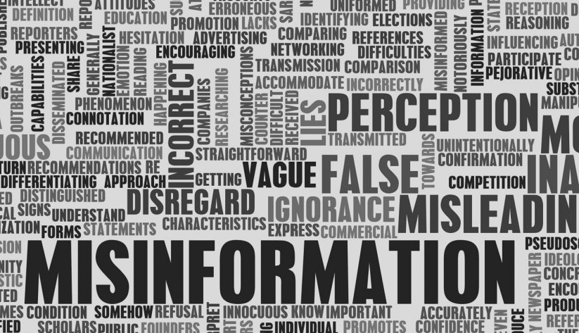
Consequences:
Distrust, confusion, chaos, barriers to freely sharing information. Decisions based on a false reality can be harmful. Participation in democracy requires informed citizens.

Slide 14
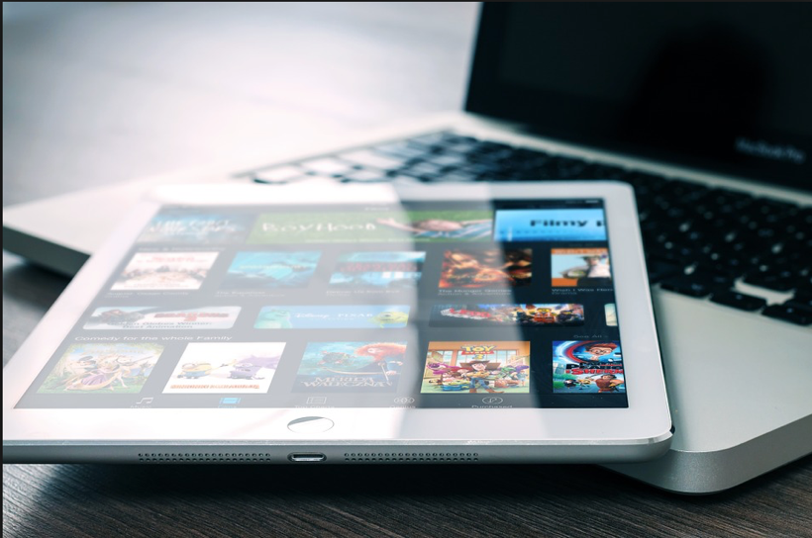
Causes
Receivers:
Technology: The Internet
Social Media
Motivations
Self-perpetuating echo chambers and filter bubbles.

Slide 15
Sources of misinformation and disinformation: Individuals and Large Entities
Misinformation can be the result of being uninformed, or making an honest mistake, or sharing inaccurate information due to failure or inability to make good judgments or to discern between high and low quality information.
Disinformation can be generated by governments, in the form of propaganda, also in the course of operations designed to achieve a goal at the expense of an adversary.

Slide 16








Media
Failures due to profit motive and decline of journalism in general, the
favoring of spectacle over substance. Also, “news deserts” and a weak press.

Slide 17
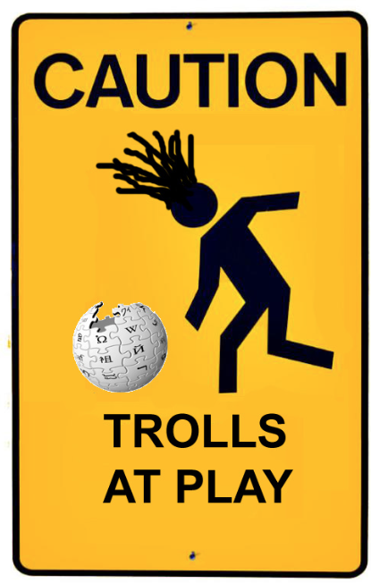
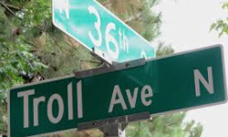

Trolls, Hackers and Information Warfare
“Disinformation is targeted at a variety of audiences.”
1. ordinary citizens
2. politicians and public figures
Cost benefit: “Spreading disinformation online is cheap”, “It can also be spread and multiplied across borders very efficiently.”
“…trolls…produce hundreds of comments during a 12-hour shift” “…one of the goals of info-war is to create chaos not only online in the information sphere but also within society itself.
The result is trolls impact free exchange of ideas and discourse, “people silenced, people confused.”
- Aro, J. (2016). “The cyberspace war: Propaganda and Trolling as Warfare tools.”

Slide 18
Examples:
Misinformation:
Opposition to vaccination due to belief in a discredited study. Climate change deniers may deny global warming based on inaccurate or misleading information.
Disinformation:
Using purposely created false information to destroy a political opponent or undermine opposition and manipulate public opinion that is intended to result in action to achieve goal.
Climate change deniers may assert global warming is a hoax despite overwhelming evidence to the contrary because actions to combat it may impact financial and economic interests.
Another example relevant to the function of a democracy and informed citizenry is the attempt of foreign adversaries, such as Russia, to influence the American presidential election, or Russia’s involvement in the Ukrainian conflict, or Russia’s attempts to influence public opinion in Finland to favor a pro-Russian stance.

Slide 19
Serious consequences:
Silencing dissenting voices
Undermining democracy, trust in information veracity
Fear and confusion impacting decision making
False perception of reality

Slide 20

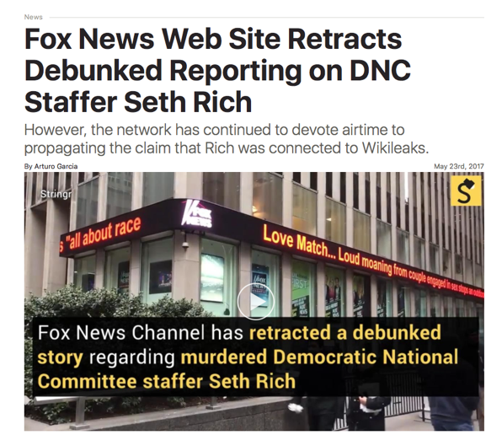
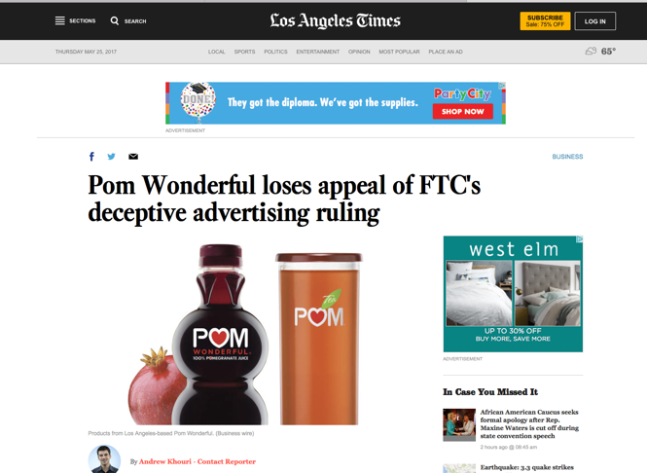
Disinformation can take the following forms: Forged documents, doctored photographs, faked maps, government propaganda, political propaganda, advertising, business information designed to harm competitors.
Dissemination of Disinformation:
-Memes, news media, social media, commercials, “kompromat” or strategic narratives launched by governments to influence popular opinion in their favor.

Slide 21
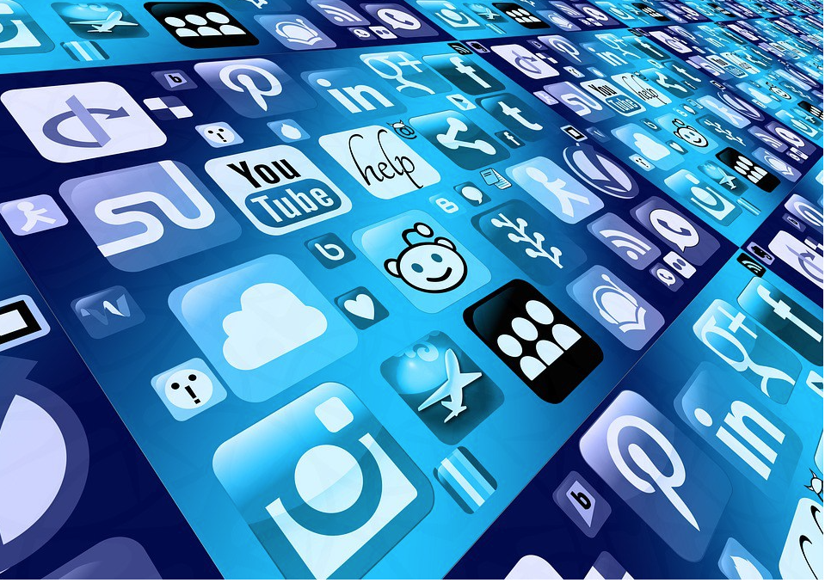
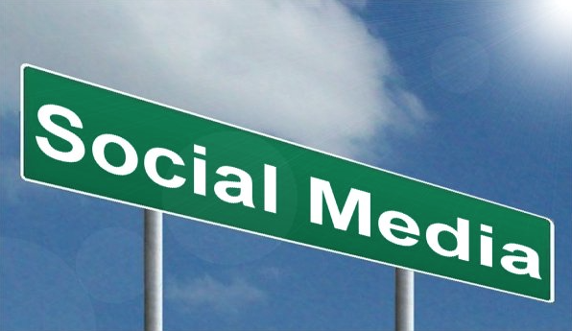
Complex, key points:
Technology enables rapid information sharing.

Slide 22
Information Overload
Users experience information overload and have limited attention.

Slide 23


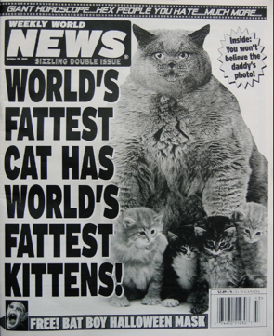
Social Media
Social media moves quickly, information disseminates and diffuses rapidly. This impacts the ability to discriminate between high and low quality information.
A factor in sharing misinformation is that people simply enjoy sharing information, no matter it’s quality.

Slide 24
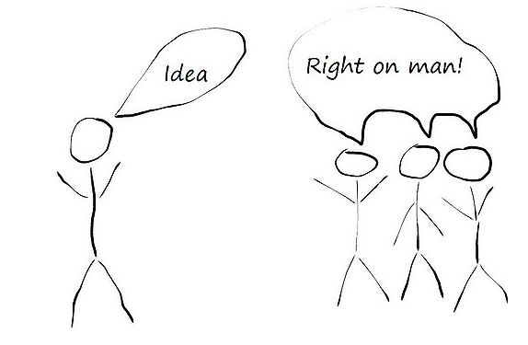
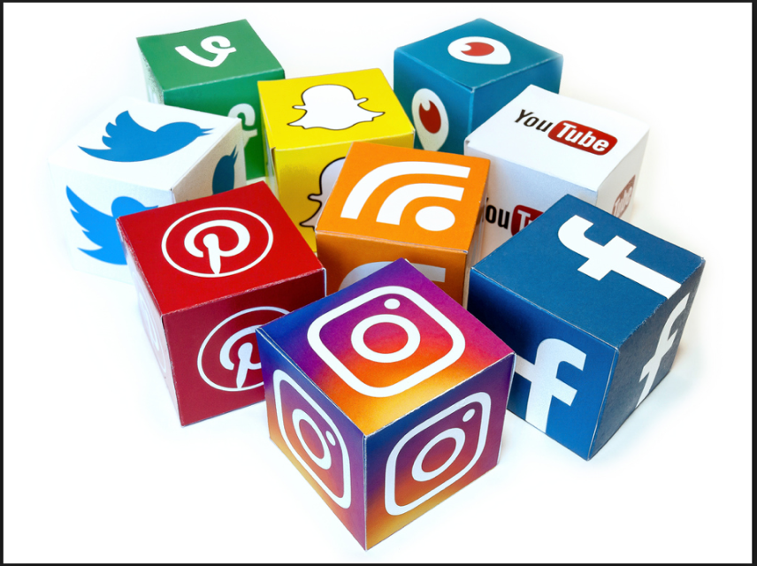
Echo-Chambers and Confirmation Bias

Slide 25
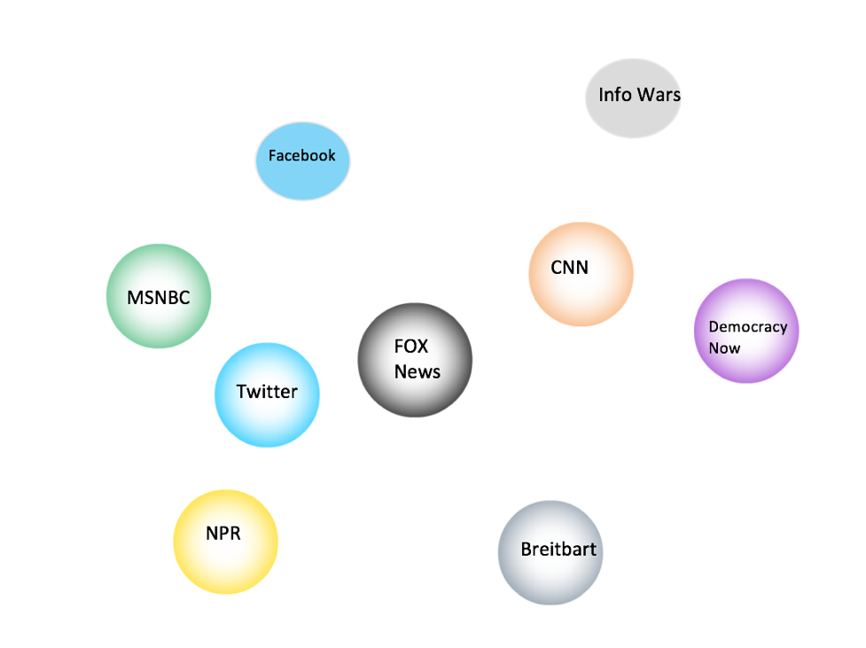
Filter Bubbles and Echo-Chambers
Algorithm driven social media and news feeds create “filter bubbles”, or “echo chambers” in which ideas are not challenged by other voices and confirmation bias means that any information that does not fit in with existing beliefs is discarded as irrelevant, leading to further polarization. In other words, algorithms personalize news to the tastes and interests of users, filtering out opinions, points of view and facts that contradict the worldview of the user, leading to a lack of diversity of information.

Slide 26
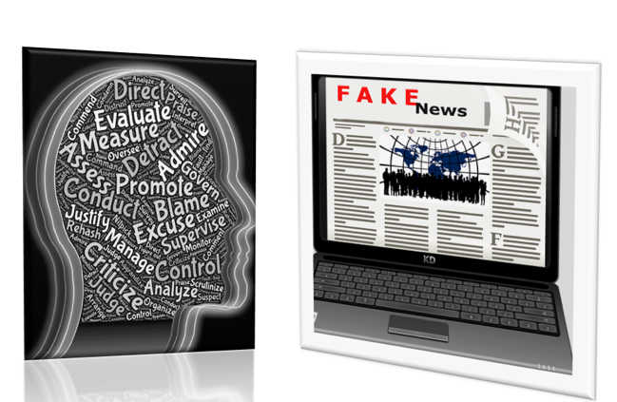

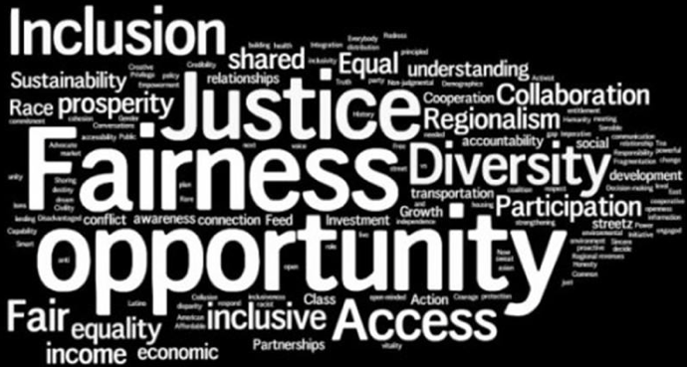
Solution:
Information literacy, digital literacy and media literacy education can address issues of critical thinking, tech skills, and the promotion of the development of detection abilities to evaluate cues that information is of low quality or inaccurate. Public libraries are “well positioned” to offer services and the mission fits with stated professional ethics guidelines (Alvarez, 2016).
Notes:
http://publiclibrariesonline.org/2017/01/feature-public-libraries-in-the-age-of-fake-news/

Slide 27
Necessary steps to offer solutions:
Understand why and how this phenomenon takes place, spanning from the theoretical to the technical.
Understand the motivations of individuals for consuming and sharing false and inaccurate information.
Understand the actors in the activity and their goals in order to educate public on information and digital literacy.
Understand how to meet users where they are, including recognizing that digital literacy and inclusion are interconnected and that individuals have unique perspectives and needs.
Understand of how to evaluate information in order to teach it to others.
Embrace of principles of critical librarianship.
Acknowledge the urgency of the problem.

Slide 28
Conclusions, Questions and Proposal
What then, is the role of information professionals in the “post-truth” era in terms of critical librarianship?
Meredith Farkas, author of “Never Neutral: Critical Librarianship and Technology” writes that critical librarianship takes the position that, “neutrality is not only unachievable, it is harmful to oppressed groups in our society (Farkas, 2017). Given recent current events in which trust in the media is now being overtly undermined, and information literacy education is crucial in order for an informed citizenry to participate fully in a democracy, exploring the role of librarians in this information ecology is a salient issue.

